Slide 1

UNIC 2020 Apotex
Case presentation
by Alishay Akmal and Don k im
Notes:
Photos by Freepik

Slide 2
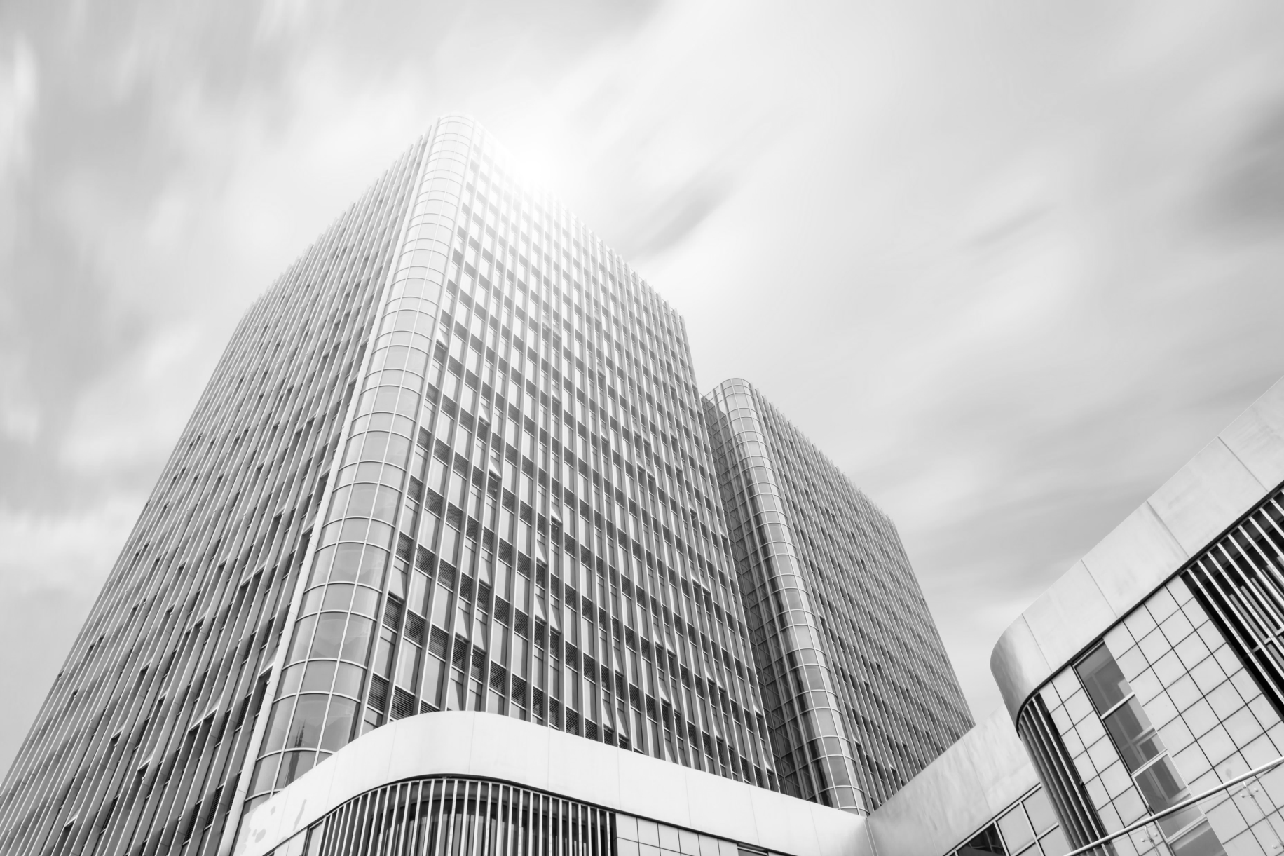
Outline
Introduction
Related Work
Materials and Methodology
Results
Discussion and Conclusions
Notes:
Small businesses can get away with a few Excel spreadsheets for tracking their operations. However, as these companies continue to grow, they can no longer keep up the speed using this simple method. At one point or another, data begins to pour in and a single-page spreadsheet transforms into a database that later grows into a data warehouse.
Without proper investment in data science projects, these companies will never unlock the potential of this data to accelerate their growth and increase their operational efficiency (for example, in building better products or delivering better services).

Slide 3
Introduction
Company
Bidding process in supply chain department
Many stakeholders
Winning rate 57.77%
Time consuming
Low winning rate
Data cleansing
Notes:
Small businesses can get away with a few Excel spreadsheets for tracking their operations. However, as these companies continue to grow, they can no longer keep up the speed using this simple method. At one point or another, data begins to pour in and a single-page spreadsheet transforms into a database that later grows into a data warehouse.
Without proper investment in data science projects, these companies will never unlock the potential of this data to accelerate their growth and increase their operational efficiency (for example, in building better products or delivering better services).

Slide 4

Overview of agenda and Understanding importance of Machine Learning
Result
Data Cleaning
Cleaning helps to focus on accurate data and understand customers need. It improves the quality of your data .
Predicting
Algorithm
Machine Learning helps to run algorithm which create pattern recognition and program to perform specific tasks
Notes:
Organizations that want to win on their markets need to know where to find the data they need and how it all ties together
born from pattern recognition and the theory that computers can learn without being programmed to perform specific tasks;

Slide 5

Merge data
Primary keys
Material number
Product family
Date
Date from customer release date
Null data was produced.
.
Notes:
Photos by rawpixel.com / Freepik

Slide 6
Data Cleaning
Data types
17 attributes
1 decision attributes (customer_response)
Merge all the data sources
Primary keys
1)Material number
2)Product Family
3)Date - Customer supply date
Classification
Logistic regression
dependent variable Binary output
(WON or LOST)
K Mean clustering
Unsupervised learning (To see what it will give us)
.
Notes:
Photos by rawpixel.com / Freepik

Slide 7
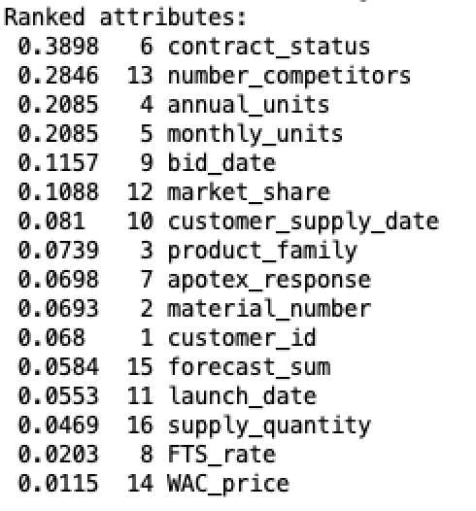
Data Finding
Correlation
Most are weak correlations
Candidates attributes are
1) Contract_status
2) Number_competitors
3) Monthly_units
4) bid_date
5) Market_share
6)Fts rate
7) forecast_sum
8) Market share
.
Notes:
Photos by rawpixel.com / Freepik

Slide 8
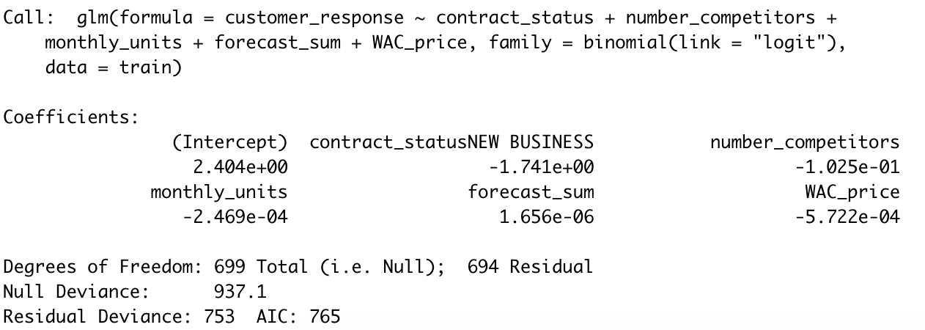
Logistic Regression
.
Notes:
Photos by rawpixel.com / Freepik

Slide 9
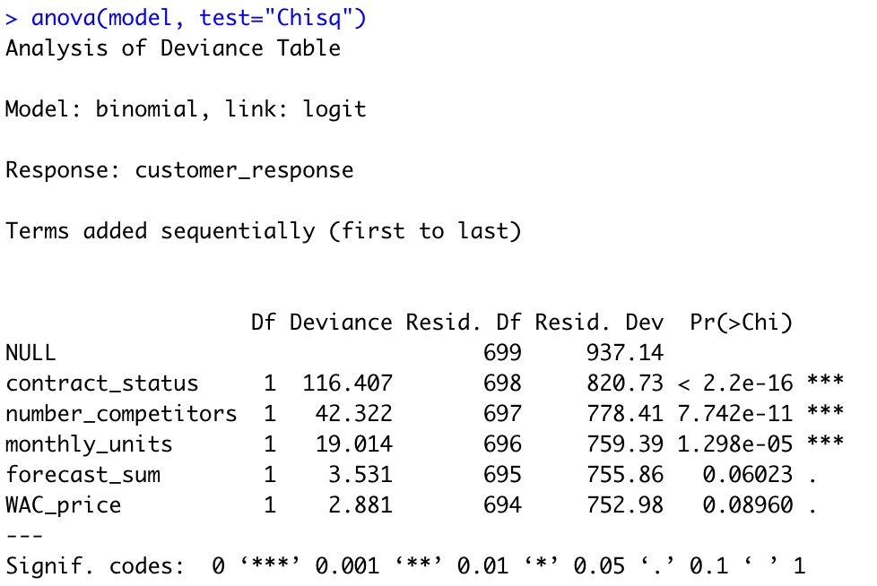
Logistic Regression (ANOVA)
Market share
not included
due to overfitting
issue
.
Notes:
Photos by rawpixel.com / Freepik

Slide 10
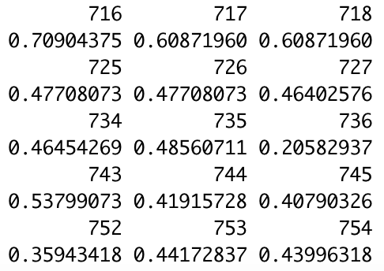
Logistic Regression Result
90% data set to get the model
10% data set to test the model
Below 0.5 Above 0.5
Accuracy 83.33%
.
Notes:
Photos by rawpixel.com / Freepik

Slide 11
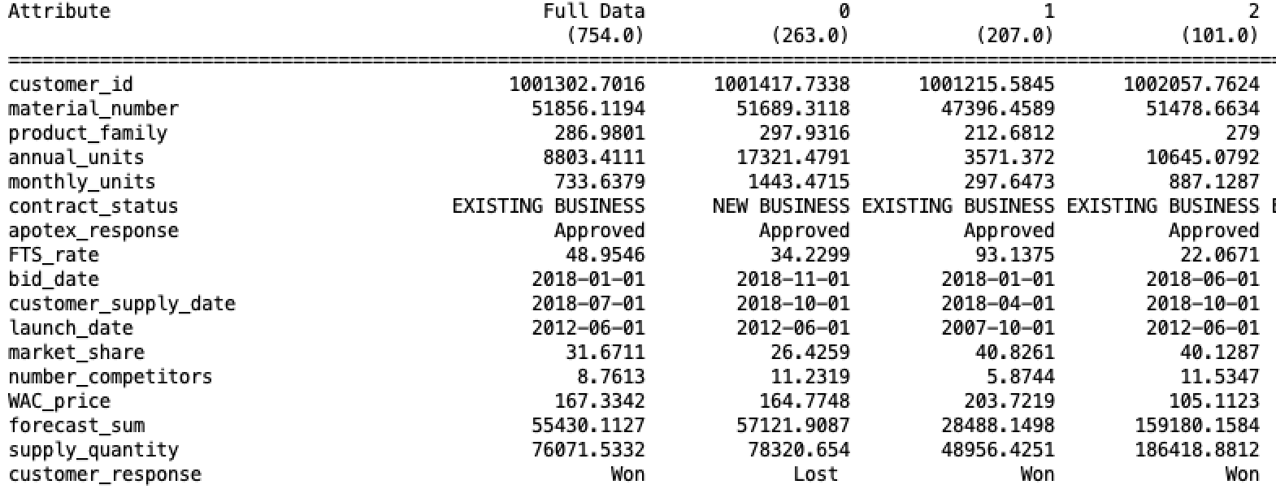
K-Mean clustering
Assess your Data
.
Notes:
Photos by rawpixel.com / Freepik

Slide 12
K-Mean clustering
Clustering the closest data nodes and find the centroid
Contract status - Existing business
Number_competition - low (if not market share should be high)
Market_share - High
Forecast_sum - High
Monthly unit - Low
.
Notes:
Photos by rawpixel.com / Freepik

Slide 13
Result
Key factor attributes
Contract_status
Number_competition
Monthly unit
Market_share
Others will play small role
.
Notes:
Photos by rawpixel.com / Freepik

Slide 14
Justification
MRP requirements will be disrupted.
New agile process will be required
Time efficiency
Higher profit
Increase in cliental
.
Notes:
improves Precision of Financial Rules and Models

Slide 15

THANK YOU
Notes:
Photos by Freepik

